Slide 1
Research Paper Presentation of IOHE
On
Machine Learning-Based Detection of Phishing Websites Using URL , Domain, and Webpage Features
By
Chirag Mittal (2210991465) | Devansh Anthal (2210991491)
Supervised By
Dr. Shikha
Associate Professor, Chitkara University
Department of Computer Science and Engineering,
Chitkara University, Punjab

Slide 2
INTRODUCTION
Why Phishing Detection Needs a Smarter Approach
Growing Threat :
Over 4.7 million phishing attacks were recorded in 2022 — a 150% increase from 2019. Attackers create fake websites mimicking banks and e-commerce sites to steal credentials and financial data.
Blacklists Are Not Enough :
Blacklist-based systems fail against newly created phishing domains active for only 24–48 hours. By the time a site is added to a blacklist, it may have already victimized thousands.
Machine Learning as the Solution :
ML models can detect previously unseen phishing websites using intrinsic features — without relying on blacklists — making them suitable for real-time deployment as browser extensions or network filters.

Slide 3
PROBLEM STATEMENT
Most phishing detection systems rely on blacklists which are inherently reactive — ineffective against new domains active for only 24–48 hours.
Existing ML models need a complete pipeline: feature extraction from URL structure, domain registration metadata, and HTML/JavaScript content.
Minimizing false negatives (missed phishing sites) is the primary security objective, as undetected phishing causes direct financial harm.
High-performing models must be computationally efficient and deployable as real-time browser extensions or network-level filters.
A standardized and reproducible benchmark evaluation of multiple classifiers on the same dataset under identical conditions is lacking.

Slide 4
OBJECTIVE
What this study aims to achieve?
Extract and analyze 30 discriminative features from URL, domain, and HTML/JS content.
Implement four classifiers: Logistic Regression, Decision Tree, Random Forest, and SVM.
Evaluate using accuracy, precision, recall, F1-score, and AUC-ROC.
Identify the most discriminative features using Random Forest importance analysis.
Build an interactive browser-based demo for real-time URL analysis.
SOLUTION
UCI Phishing Websites Dataset — 11,055 labeled samples, 30 features.
Four classifiers trained under identical conditions (80/20 stratified split).
Standard Scaler normalization for LR and SVM; raw features for tree models.
5-fold stratified cross-validation for hyperparameter tuning.
Interactive HTML/JS demo — runs in browser, no server needed.

Slide 5
METHEDOLOGY
RESEARCH FRAMEWORK AND APPROACH:
1. Dataset:
UCI Phishing Websites Dataset — 11,055 samples (51.7% phishing, 48.3% legitimate), 30 pre-encoded features with no missing values. 2. . Feature Engineering:
30 features across three categories: URL-based (length, IP in URL, @ symbol, subdomains), Domain-based (age, DNS, Alexa rank), and HTML/JS ( I frames, right-click disabled).
3. Preprocessing:
Standard Scaler normalization applied for LR and SVM. Tree-based models (DT, RF) used raw encoded features directly.
4. Training & Tuning:
80/20 stratified split (8,844 train / 2,211 test). 5-fold cross-validation for hyperparameter search. SVM: C=10, γ=scale selected via grid search.
5. Evaluation:
: Accuracy, Precision, Recall, F1-Score, Confusion Matrix, and AUC-ROC computed on the same held-out test set for all four classifiers.
….

Slide 6
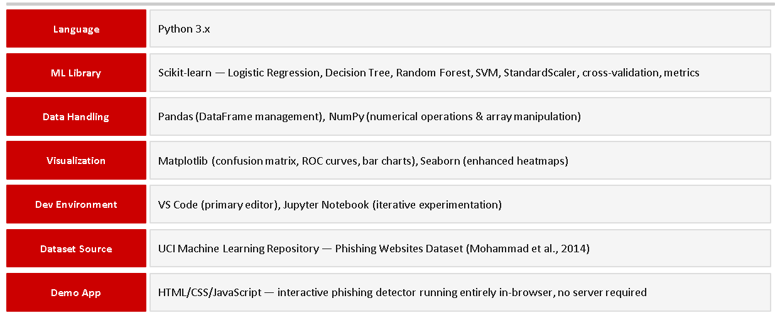
TOOLS AND TECHNOLOGIES:

Slide 7
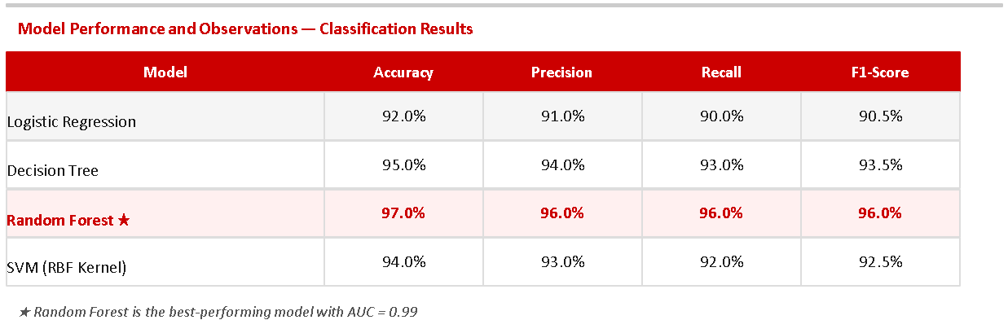
RESULTS:

Slide 8
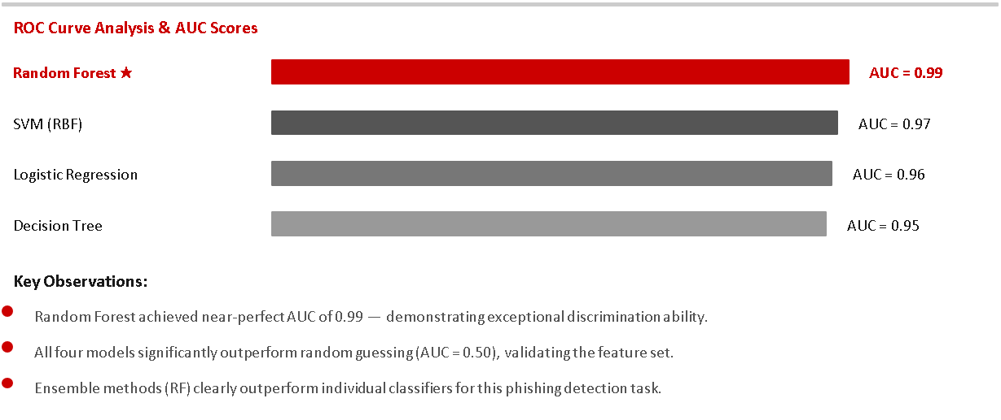
RESULTS:

Slide 9
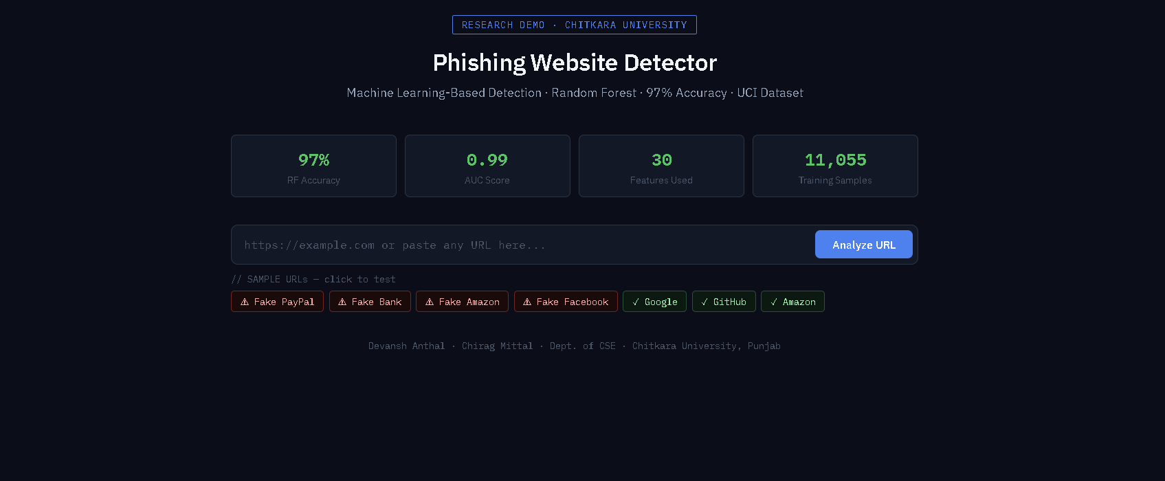
Model Output :

Slide 10
CONCLUSIONS:
Random Forest achieved 97% accuracy, 96% precision, 96% recall, 96% F1-score, and AUC = 0.99 — best among all four classifiers.
Ensemble methods clearly outperform individual classifiers (LR: 92%, DT: 95%, SVM: 94%) for phishing detection.
The framework does not require real-time page rendering or external blacklist queries — computationally efficient for deployment
Top discriminative features: URL Length, IP in URL, HTTPS token in domain, domain age, and web traffic rank.
FUTURE WORK:
Investigate XG Boost and Light GBM ensemble methods for improved accuracy and faster inference.
Explore Bidirectional LSTM and Transformer models for character-level URL sequence analysis.
Build and deploy a real-time browser extension using the trained Random Forest model.

